Slide 1






MHST12-02
FPT University

Slide 2
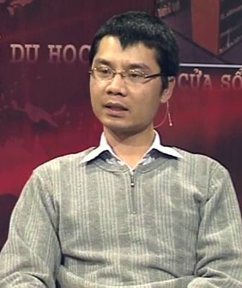




MHST12-02 TEAM
Nguyen Vu Hung
Vu Hai Nam
Mentor
Team Leader
Nguyen Ngoc Hung
Nguyen Luu Bach

Slide 3
MHST12-02 TEAM
Nguyen Vu Hung
Vu Hai Nam
Mentor
Team Leader
Nguyen Ngoc Hung
Nguyen Luu Bach

Slide 4
Contents
MHST12-02
Introduction
Project Management Plan
[Text]
[Text]

Slide 5
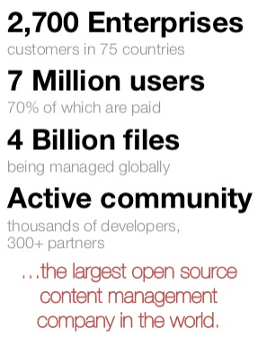
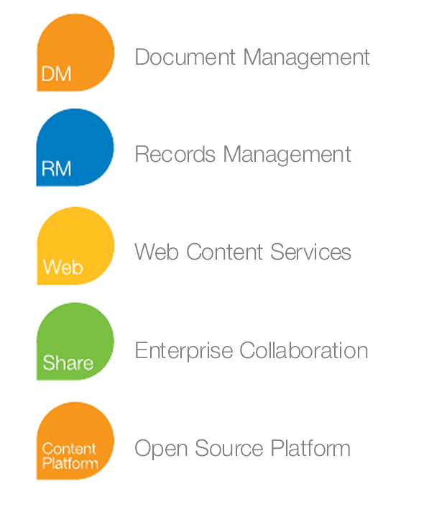
Alfresco introduction
MHST12-02

Slide 6

Alfresco introduction
MHST12-02

Slide 7
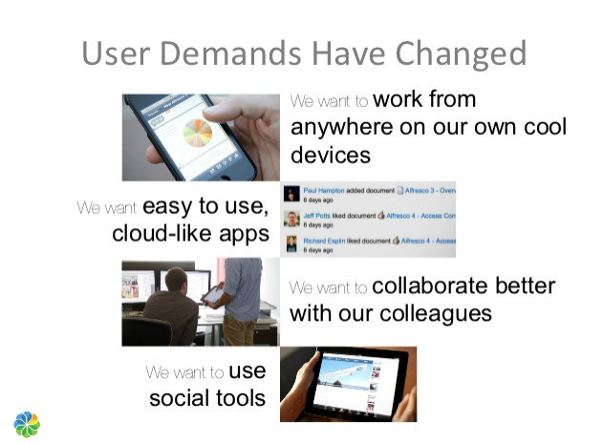
Alfresco introduction
MHST12-02

Slide 8
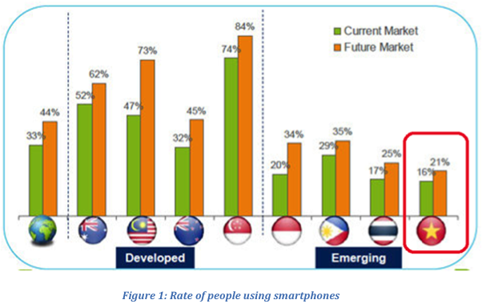
Background
MHST12-02
Trend of using smartphone in Vietnam
Source: Ericsson Consumer Lab 2012

Slide 9
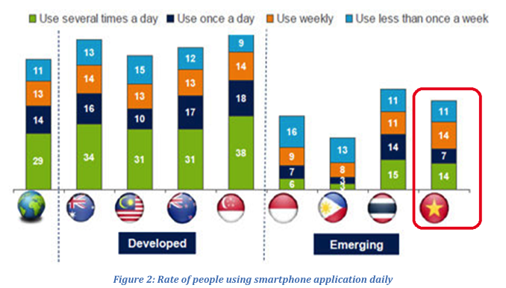
Background
MHST12-02
Trend of using smartphone in Vietnam
Source: Ericsson Consumer Lab 2012

Slide 10
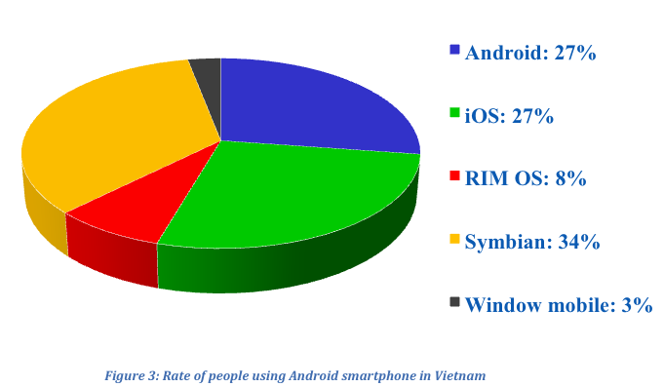
Background
MHST12-02
Trend of using smartphone in Vietnam
Source: Ericsson Consumer Lab 2012

Slide 11
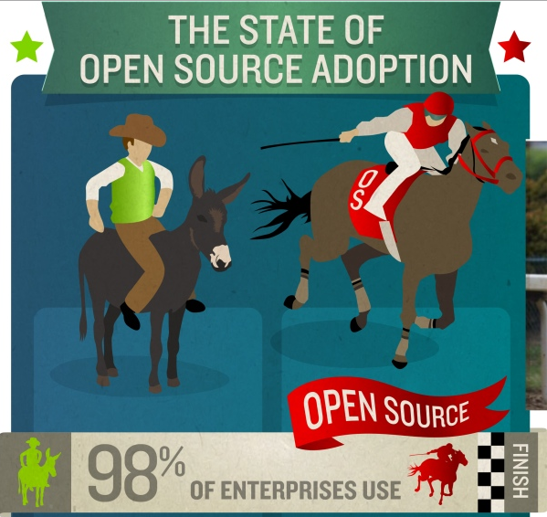
Open source
MHST12-02
(http://www.onlinemarketing-trends.com/2011/05/open-source-adoption-timeline.html)

Slide 12
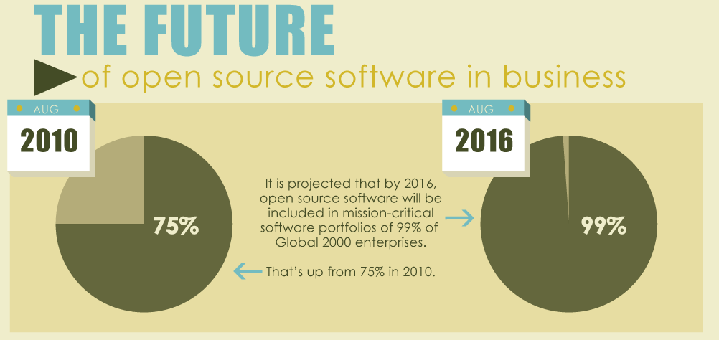
Open source
MHST12-02
(http://blog.sourceninja.com/the-history-of-open-source-software/)

Slide 13
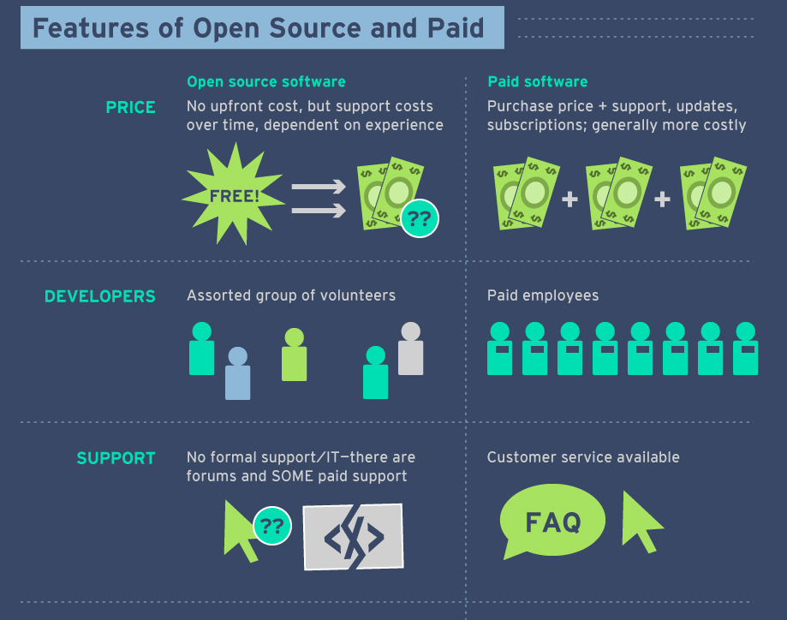
Open Source vs Paid Source
MHST12-02
(http://blog.sourceninja.com/the-history-of-open-source-software/)

Slide 14
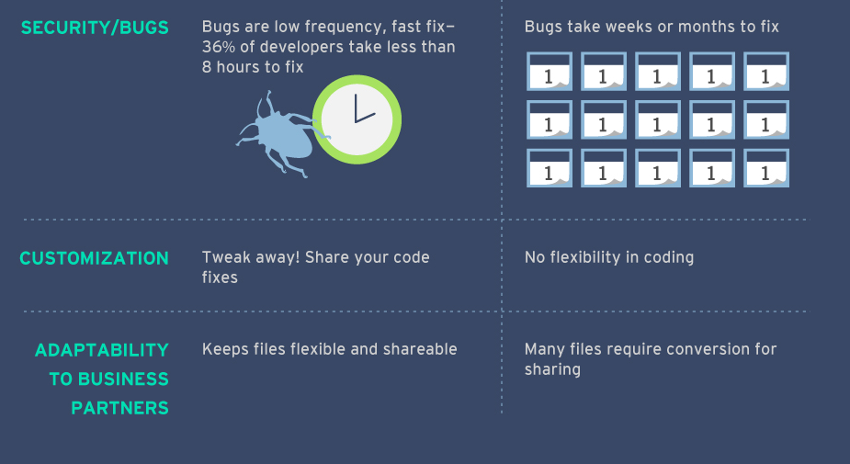
(http://blog.sourceninja.com/open-source-software-vs-paid-software)

Slide 15


Evaluation & Chance
MHST12-02

Slide 16
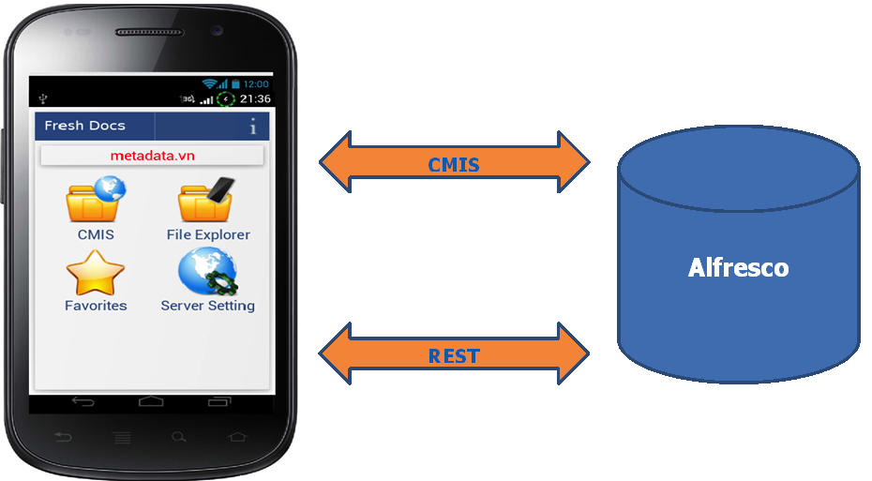
Proposed System
MHST12-02

Slide 17
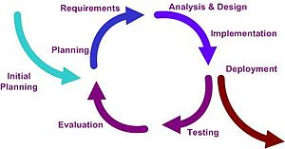
Software Process Model
MHST12-02
- Incremental delivery
- Easy for team members who don’t have much experience
- Easily identify the source of last error
- Less time for corrections
Iterative Model

Slide 18




Team Work
MHST12-02

Slide 19
Development Tools
MHST12-02
Hardware
Software

Slide 20
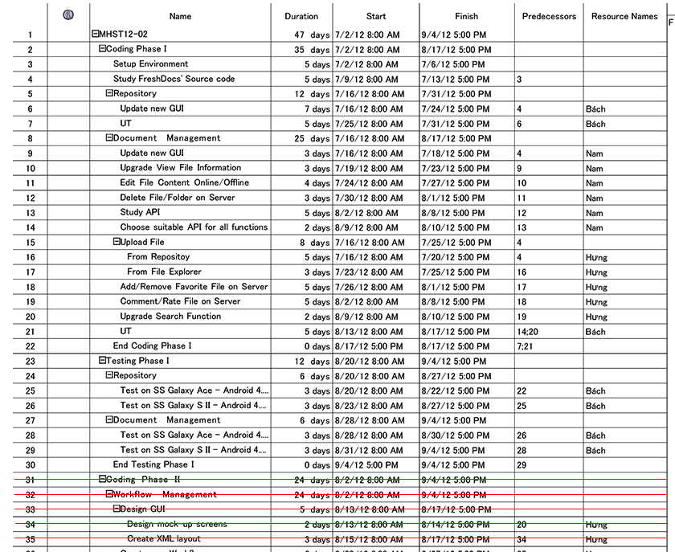
Work breakdown structure
MHST12-02

Slide 21
Gantt Chart
MHST12-02

Slide 22
ENJOY YOUR TIME
WITH

